Slide 1
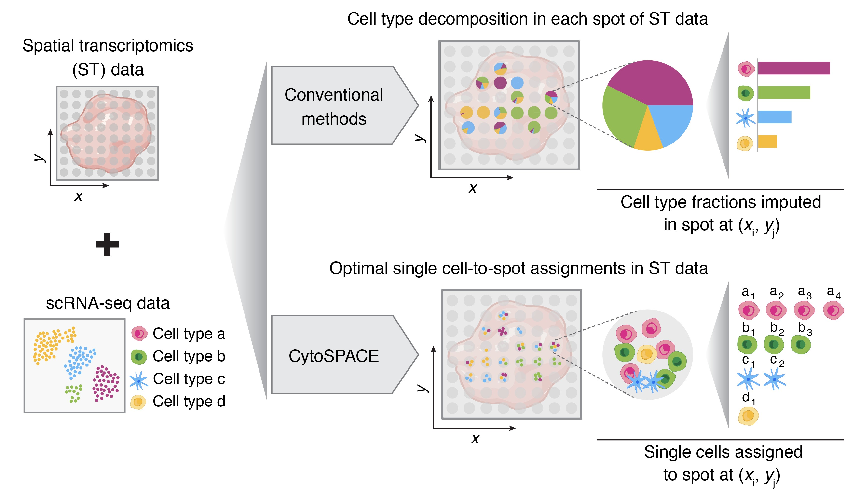
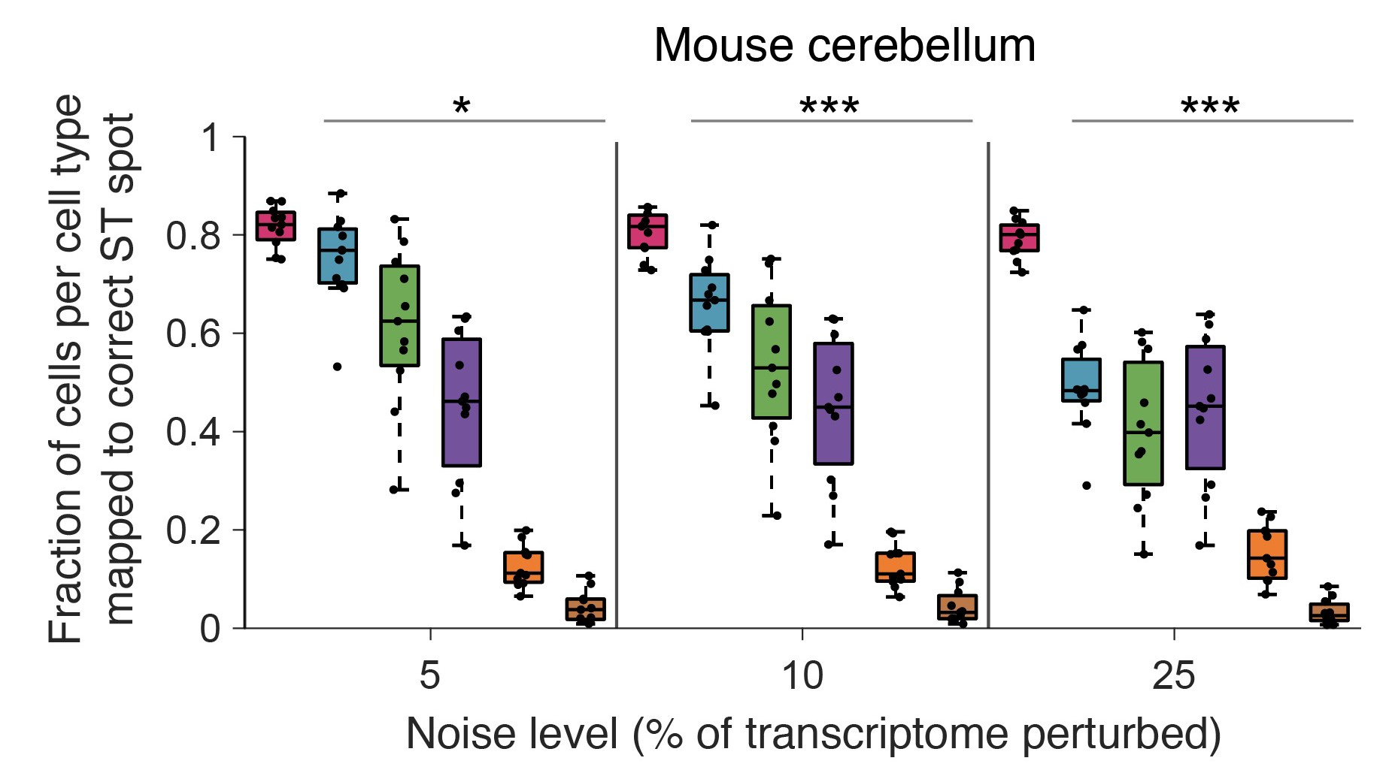
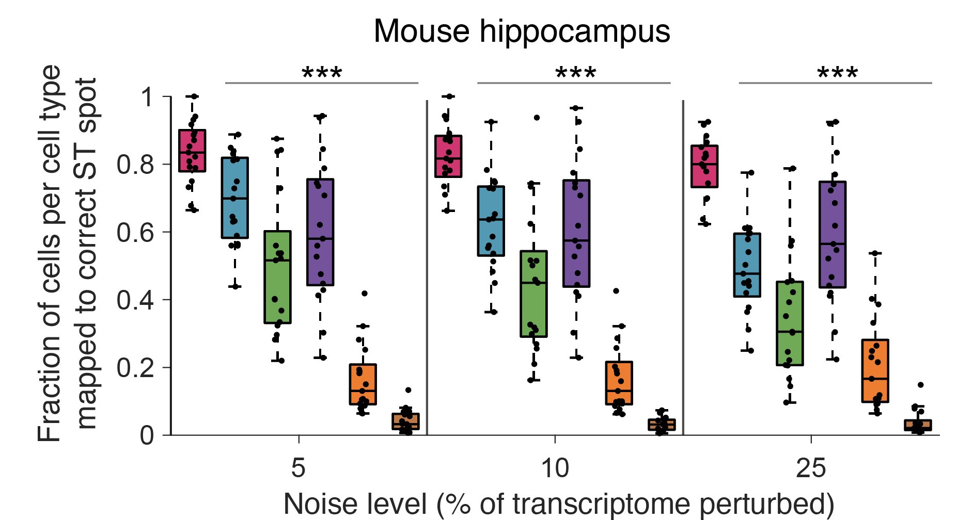
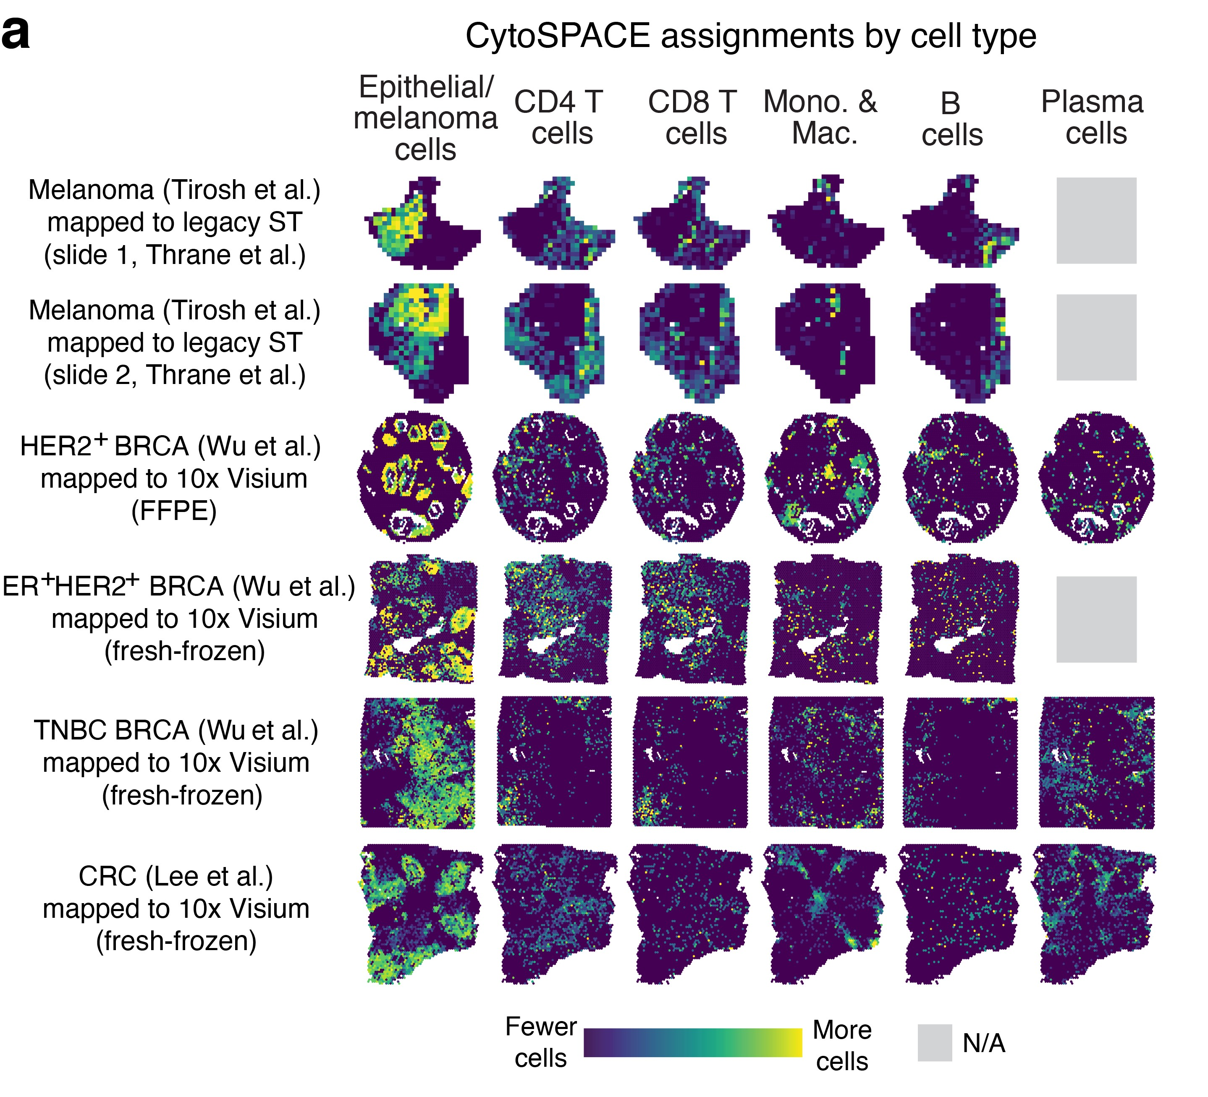
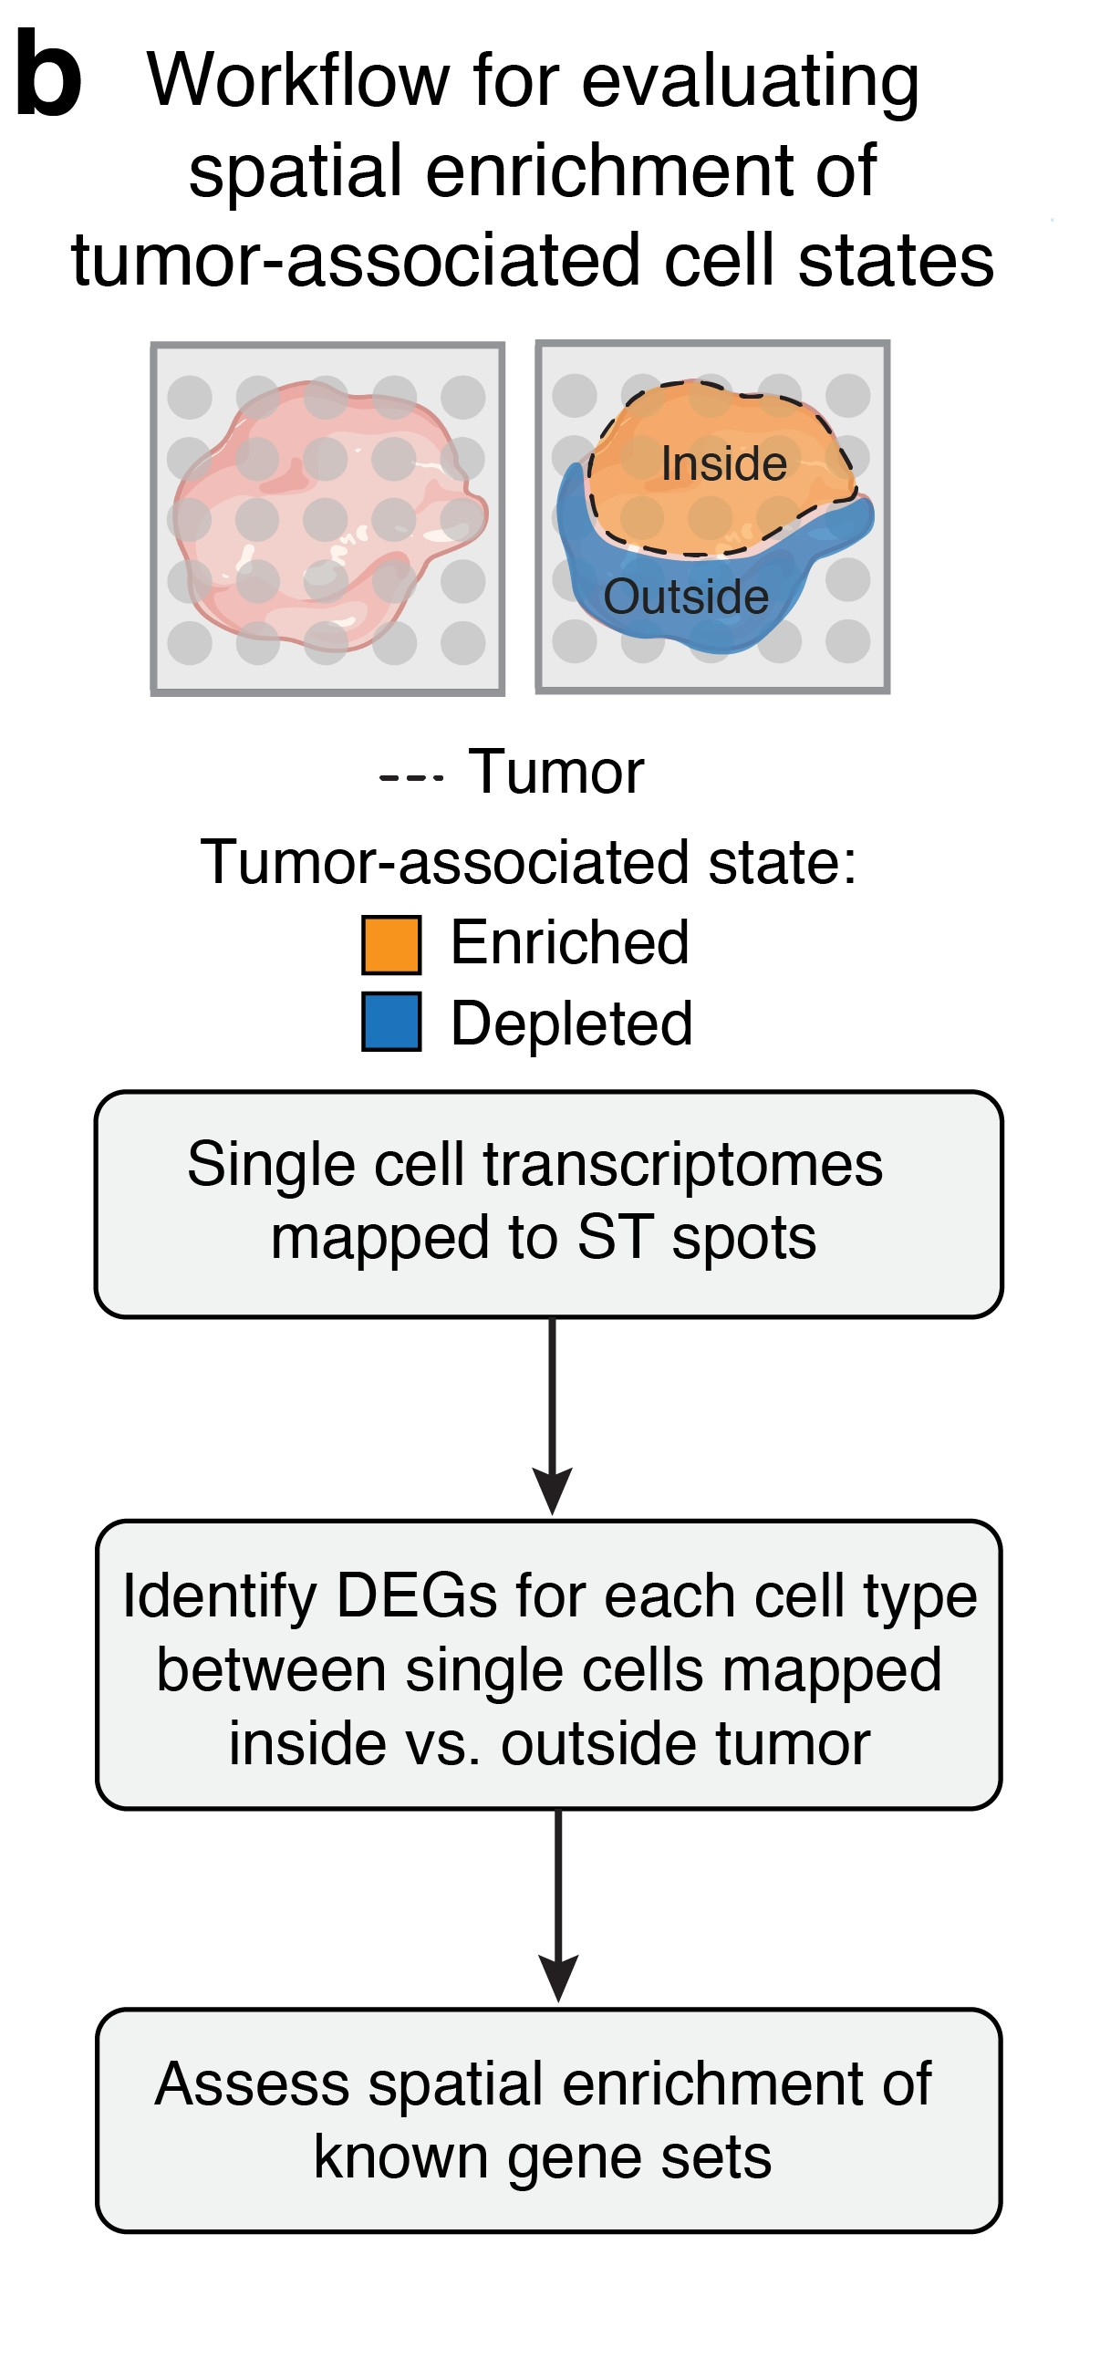
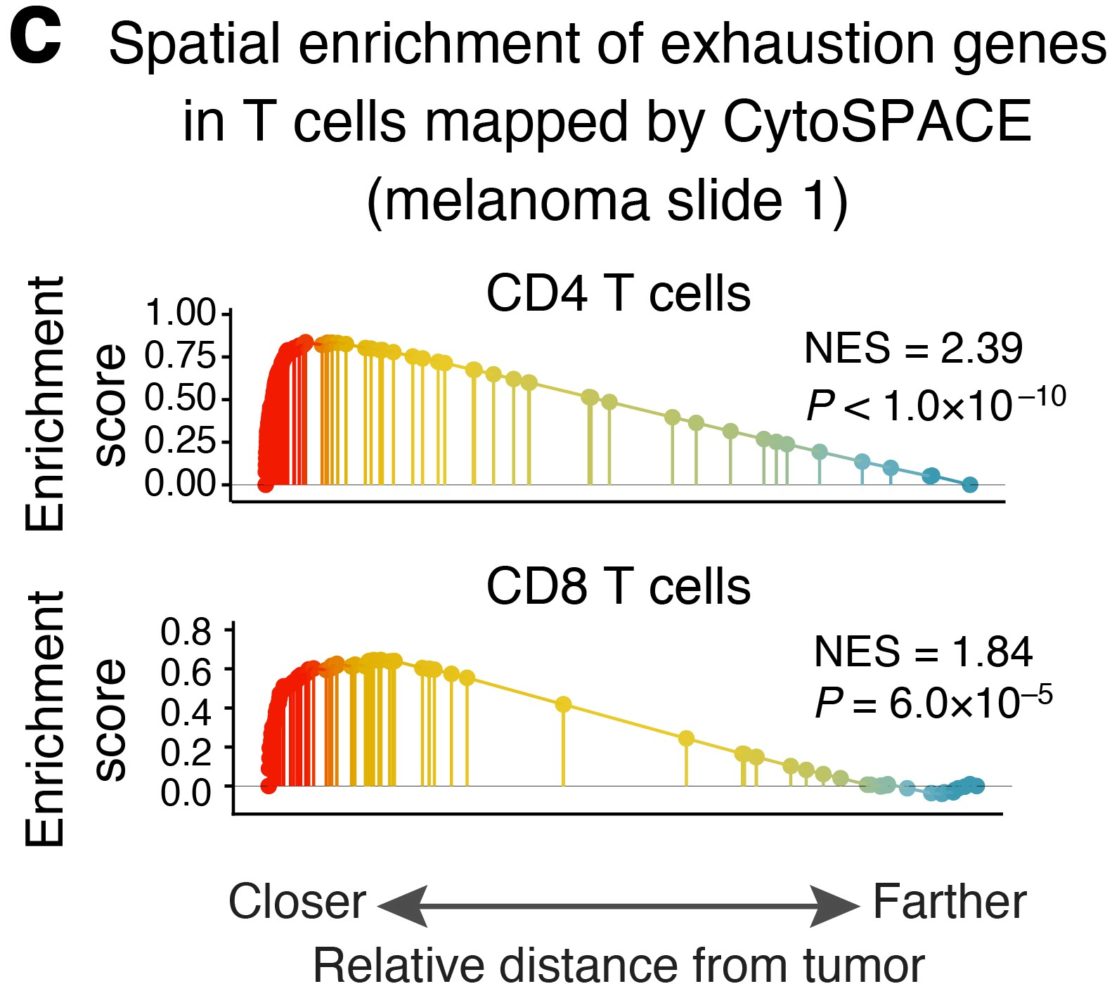
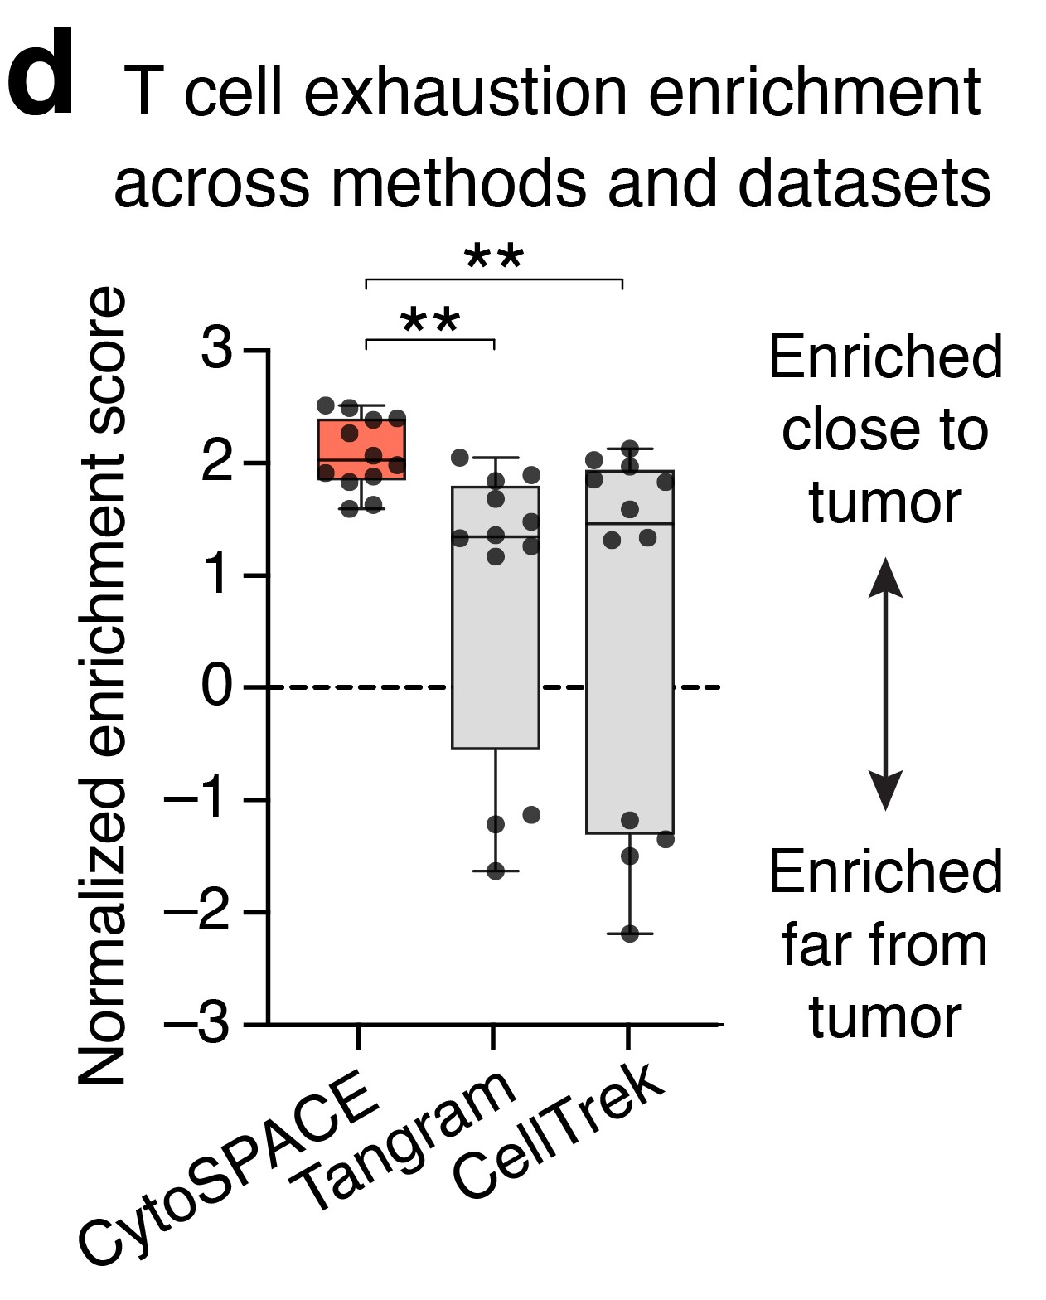
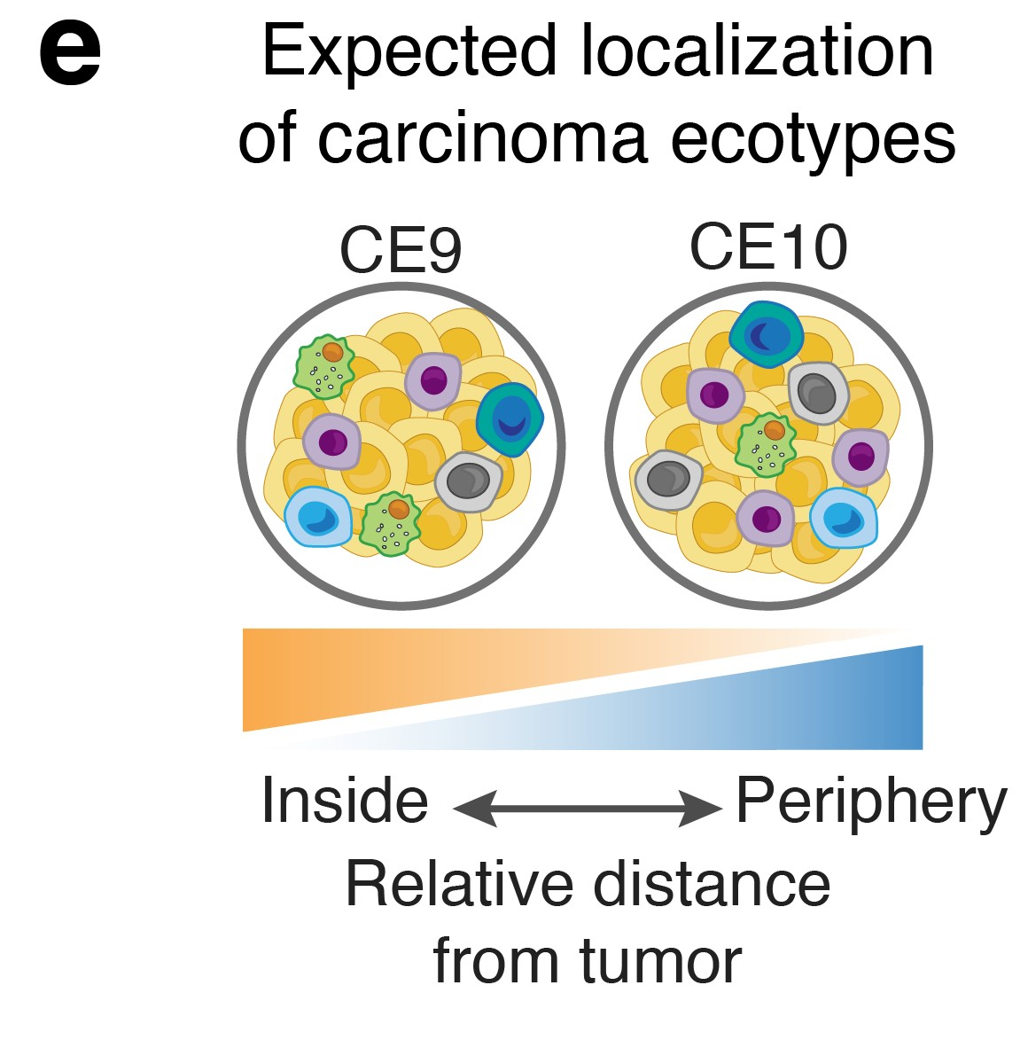
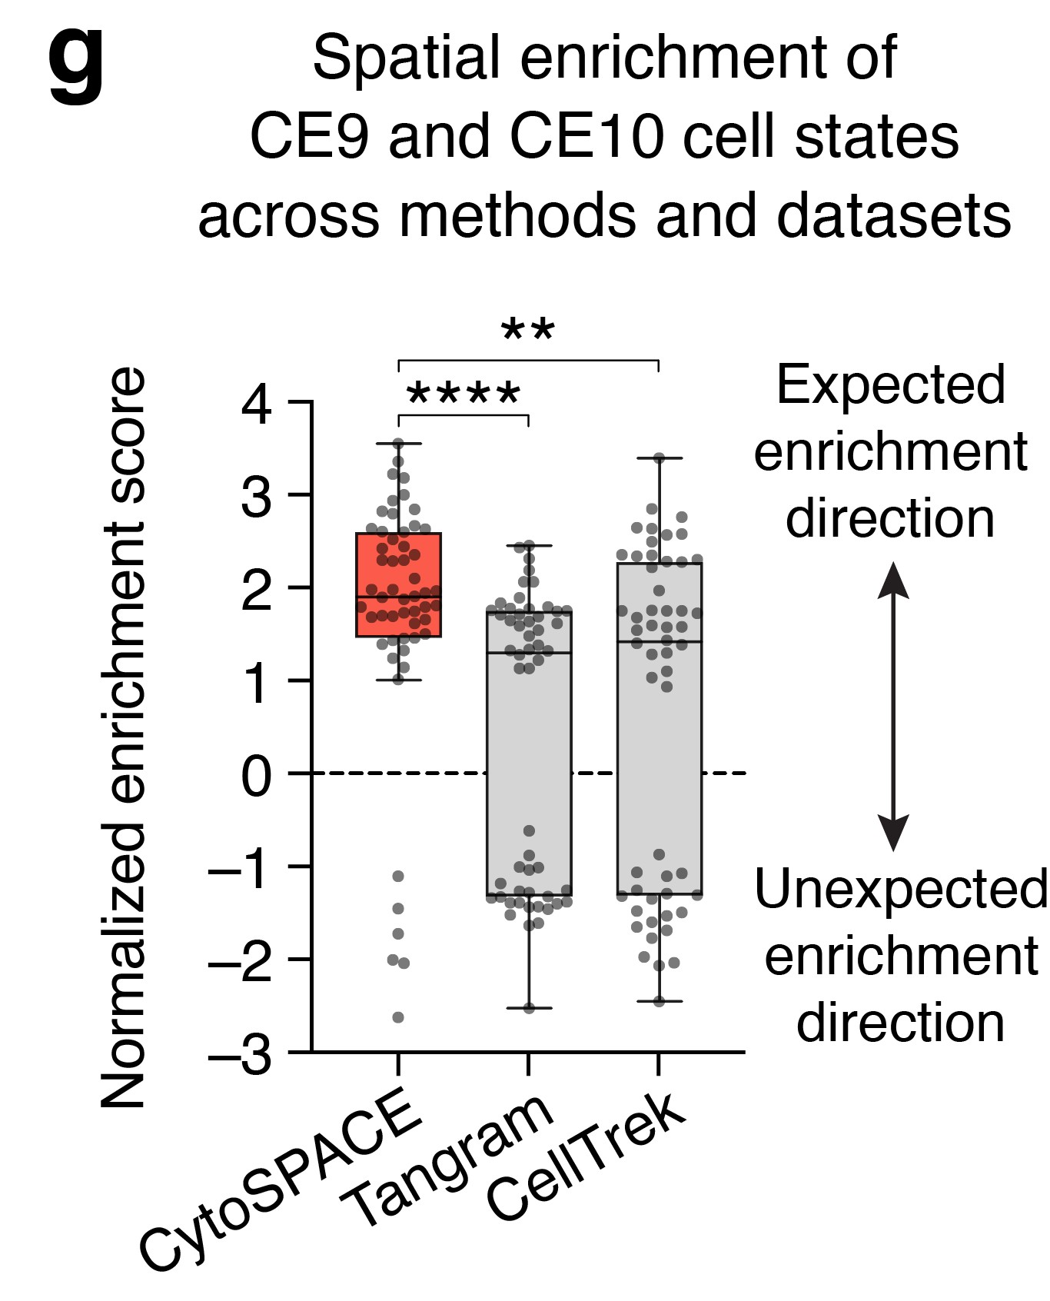
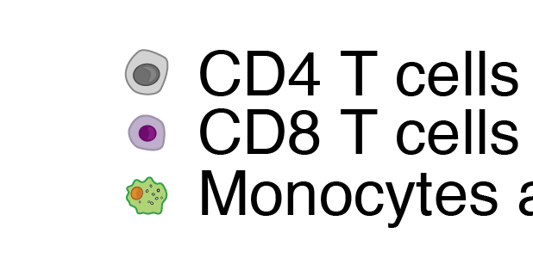
Robust alignment of single-cell and spatial transcriptomes with CytoSPACE
Erin L. Brown^{1,*}, Milad R. Vahid^{1,*}, Chloé B. Steen^{1,2,*}, Minji Kang¹, Andrew J. Gentles¹, Aaron M. Newman^{1,#}
Contact
Erin L. Brown browne@stanford.edu Aaron M. Newman amnewman@stanford.edu
¹Stanford University, Stanford, CA; ²Oslo University Hospital, Oslo, Norway; *Contributed equally
BACKGROUND METHOD
Single-cell spatial organization is a key determinant of cell state and function. For example, in human tumors, local signaling networks differentially impact individual cells and their surrounding microenvironments, with implications for tumor growth, progression, and response to therapy¹⁻⁶.
Commonly used spatial transcriptomic (ST) platforms such as 10x Visium remain limited to bulk gene expression measurements, where each spatially-resolved expression profile is derived from as many as 10 cells or more⁷.
To address this challenge, we designed CytoSPACE, a computational framework for assigning single-cell transcriptomes to ST spots.
2. CytoSPACE workflow
Figure 2: Schematic of a typical CytoSPACE workflow. Given an ST dataset 𝐴𝐴 and an annotated scRNA-seq dataset 𝐵𝐵 where the latter covers major cell types in 𝐴𝐴, CytoSPACE consists of the following key steps: (1) application of an existing ST deconvolution method to estimate cell type fractions in 𝐴𝐴 using reference profiles from 𝐵𝐵, (2) estimation of the number of cells per spot in 𝐴𝐴, (3) sampling of 𝐵𝐵 to match the inferred number of cells per cell type in 𝐴𝐴, and (4) alignment of single-cell and spatial transcriptomes (𝐴𝐴 → 𝐵𝐵) using shortest augmenting path-based optimization.
1. CytoSPACE versus conventional methods
RESULTS
3. Benchmarking CytoSPACE in simulation
a
c
Benchmarking single-cell spatial assignment (mean 5 cells per spot)
Figure 1: Unlike conventional methods which only obtain cell type fraction estimates per ST spot, CytoSPACE optimally maps single-cell transcriptomes to ST spots.
b
CONCLUSIONS
CytoSPACE accurately assigns single-cell transcriptomes to ST spots, resulting in a reconstructed tissue specimen with both high gene coverage and spatially-resolved scRNA-seq data suitable for downstream analysis, including the discovery of context-dependent cell- states.
Across diverse platforms and tissue types, CytoSPACE outperforms previous methods with respect to noise-tolerance, accuracy, and efficiency, enabling improved analysis of spatial transcriptomics data at single-cell resolution.
CytoSPACE runs in approximately 5 minutes on a single processor and does not require a GPU, offering a 5-10x speedup over alternative methods.
CytoSPACE is available as an open-source Python package and can be found at:
https://github.com/digitalcytometry/cytospace
Figure 3: Benchmarking CytoSPACE in simulation. (a) Framework design for CytoSPACE simulation. (b) Comparison of CytoSPACE cell-to-spot assignments against ground truth. (c) Comparison of CytoSPACE cell-to-spot assignment precision against recently published^{8,9} and naïve methods.
4. Single-cell cartography of TME communities
REFERENCES
Keren, L., et al. A Structured Tumor-Immune Microenvironment in Triple Negative Breast Cancer Revealed by Multiplexed Ion Beam Imaging. Cell 174, 1373-1387 e1319 (2018).
Schürch, C.M., et al. Coordinated Cellular Neighborhoods Orchestrate Antitumoral Immunity at the Colorectal Cancer Invasive Front. Cell 182, 1-19 (2020).
Jackson, H.W., et al. The single-cell pathology landscape of breast cancer. Nature 578, 615- 620 (2020).
Luca, B.A., et al. Atlas of clinically distinct cell states and ecosystems across human solid tumors. Cell 184, 5482-5496.e5428 (2021).
Grünwald, B.T., et al. Spatially confined sub-tumor microenvironments in pancreatic cancer.
Cell 184, 5577-5592.e5518 (2021).
Nalio Ramos, R., et al. Tissue-resident FOLR2+ macrophages associate with CD8+ T cell infiltration in human breast cancer. Cell 185, 1189-1207.e1125 (2022).
Hu, J., et al. Statistical and machine learning methods for spatially resolved transcriptomics with histology. Comput Struct Biotechnol J 19, 3829-3841 (2021).
Biancalani, T., et al. Deep learning and alignment of spatially resolved single-cell transcriptomes with Tangram. Nature Methods 18, 1352-1362 (2021).
Wei, R., et al. Spatial charting of single-cell transcriptomes in tissues. Nature Biotechnology
(2022).
f
Figure 4: Recovery of spatial localization of cell states in the tumor microenvironment. (a) CytoSPACE cell-to-spot assignments. (b) Framework for spatial cell state enrichment analysis. simulation. (c) Sample results for T cell exhaustion enrichment localization in melanoma. (d) Carcinoma ecotypes⁴. (e) Benchmarking recovery of T cell exhaustion enrichment. (f) Benchmarking recovery of carcinoma ecotype cell states.

